Slide 1
Data Science Methods for Clean Energy Research
Unsupervised Learning: Principal components analysis(PCA), clustering, self-organizing map(SOM)
March 1, 2020

Slide 2
Outline
Comparison of supervised vs. unsupervised learning
Principal components analysis (PCA)
Clustering
Self-organizing map (SOM)

Slide 3
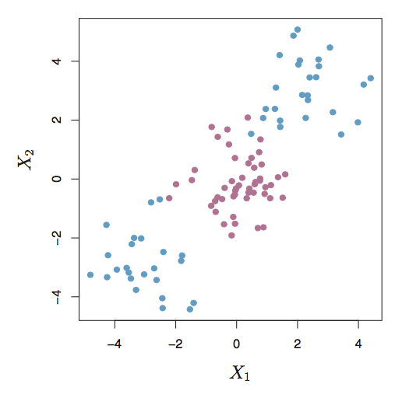
Supervised vs. unsupervised learning
Consider the X1/X2 data below. Imagine the scenario in which we did not know in advance the response Y (the color of the circle or class)
Main goal:
Use a large set of features (X) [there are no longer any responses, Y!] and determine how the data may be grouped together
Central challenge in unsupervised learning:
How to validate the data?
Or... Is there any “answer” ?

Slide 4
Two concepts in unsupervised learning
Find reduced dimensional representation of data that sub-describes most of the variance: principal components analysis (PCA)
Find similar sub-groups of data within our total data set: clustering

Slide 5
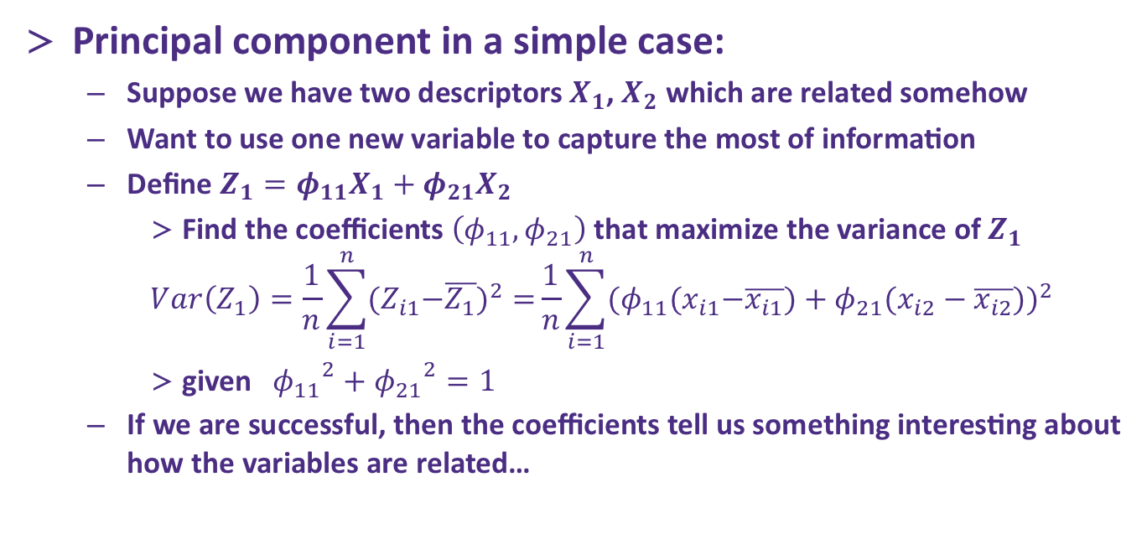
Principal Components Analysis(PCA)
Principal component in a simple case:
Suppose we have two descriptors $X_{1}$, $X_{2}$ which are related somehow
Want to use one new variable to capture the most of information
Define $Z_{1}=φ_{11}X_{1}+φ_{21}X_{2}$
Find the coefficients $\left(φ_{11},φ_{21}\right)$ that maximize the variance of $Z_{1}$
$$Var\left(Z_{1}\right)=\frac{1}{n}\sum_{i=1}^{n}{{{(Z}_{i1}−\overline{Z_{1}})}^{2}=}\frac{1}{n}\sum_{i=1}^{n}{{{(φ}_{11}{(x}_{i1}−\overline{x_{i1}})+φ_{21}(x_{i2}−\overline{x_{i2}}))}^{2}}$$
given ${{ φ}_{11}}^{2}+{φ_{21}}^{2}=1$
If we are successful, then the coefficients tell us something interesting about how the variables are related…
Notes:
Warning: need to get away from thinking of this a prediction/response!

Slide 6
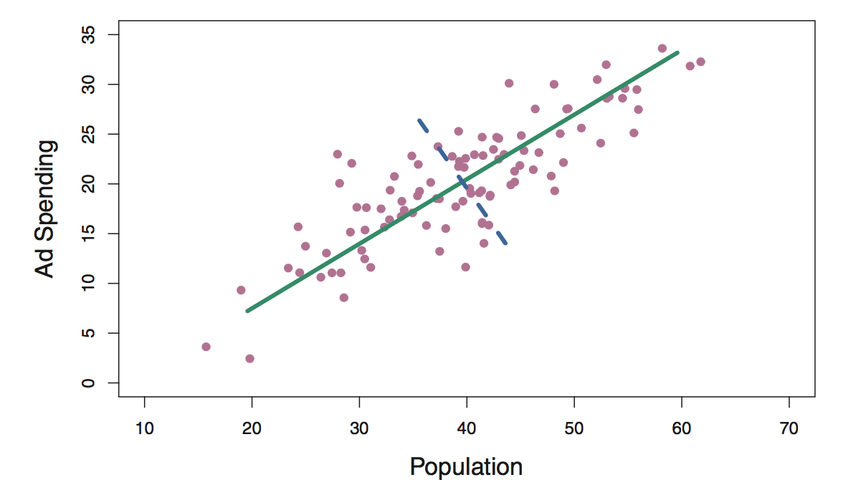
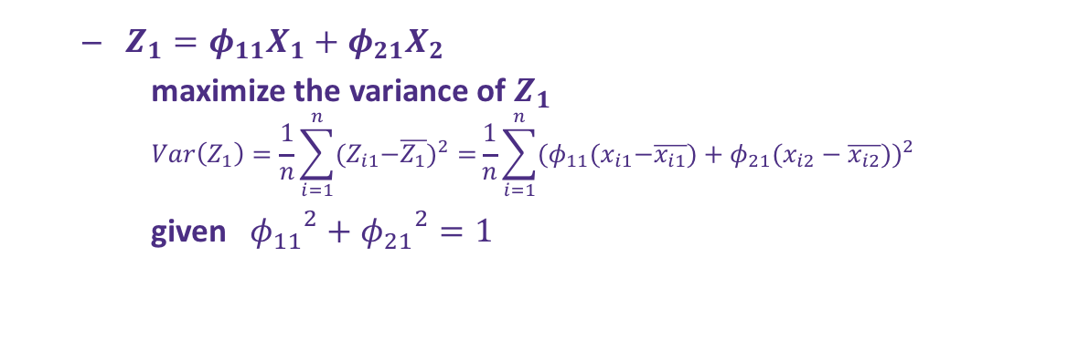
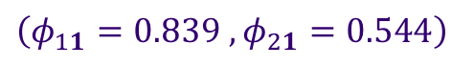
Principal Components Analysis(PCA)
$Z_{1}=φ_{11}X_{1}+φ_{21}X_{2}$
maximize the variance of $Z_{1}$
$$Var\left(Z_{1}\right)=\frac{1}{n}\sum_{i=1}^{n}{{{(Z}_{i1}−\overline{Z_{1}})}^{2}=}\frac{1}{n}\sum_{i=1}^{n}{{{(φ}_{11}{(x}_{i1}−\overline{x_{i1}})+φ_{21}(x_{i2}−\overline{x_{i2}}))}^{2}}$$
given ${{ φ}_{11}}^{2}+{φ_{21}}^{2}=1$
Example: Ad spending and Population of 100 cities
The direction of first principal component is shown by the green solid line :
$\left(φ_{11}=0.839 , φ_{21}=0.544\right)$
Eq 6.19 / Fig 6.14
Notes:
Warning: need to get away from thinking of this a prediction/response!

Slide 7
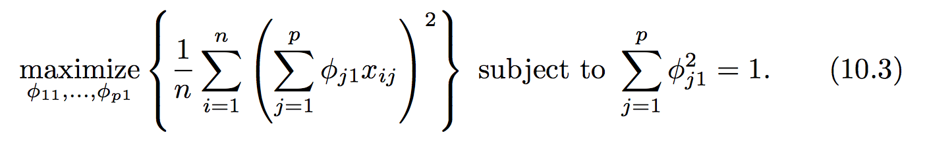
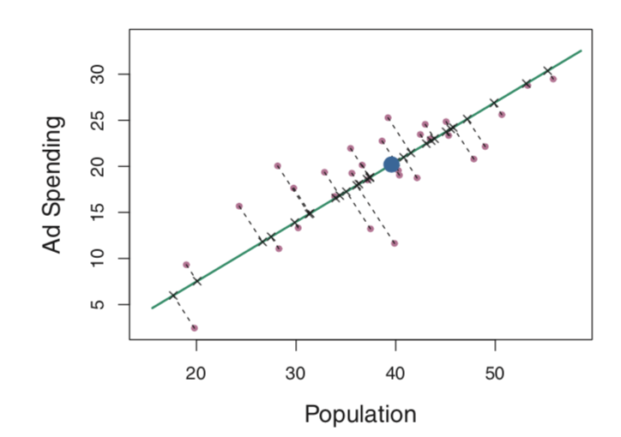
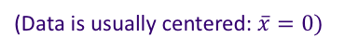
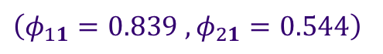
PCA definitions and concepts
The first principal component (Z₁) is determined by solving
The coefficients φ are known as loadings for each of the descriptors
The first principal component direction of the data is that along which the observations vary the most.
(Data is usually centered: $\overline{x}=0)$
Example:
$\left(φ_{11}=0.839 , φ_{21}=0.544\right)$
Eq 6.19 / Fig 6.15

Slide 8
The 2nd principal component
But what if there are other variables that help describe the variance in our observables?
The 2nd PC (Z₂) is the linear combination of φ_{j2}X_{j} that has maximum variance:
Additional constraint: Z₂ must be orthogonal, or totally uncorrelated to Z₁

Slide 9
How to solve PCA
There are many principal components, they are usually determined through eigen decomposition of the covariance matrix of X

Slide 10
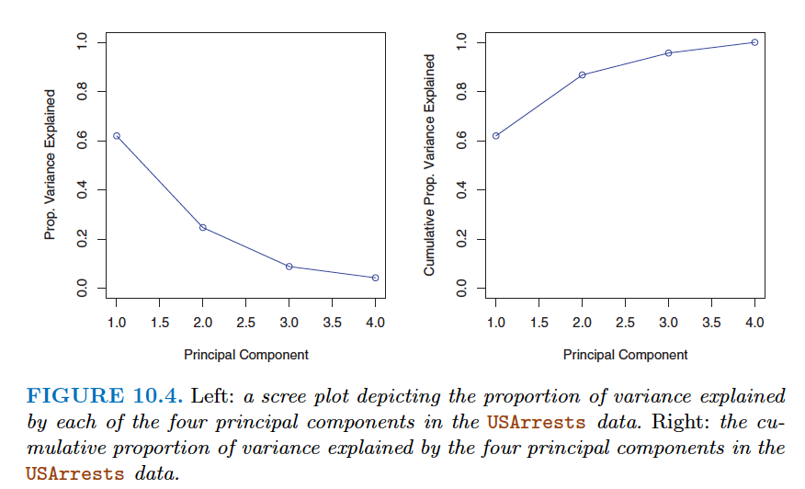
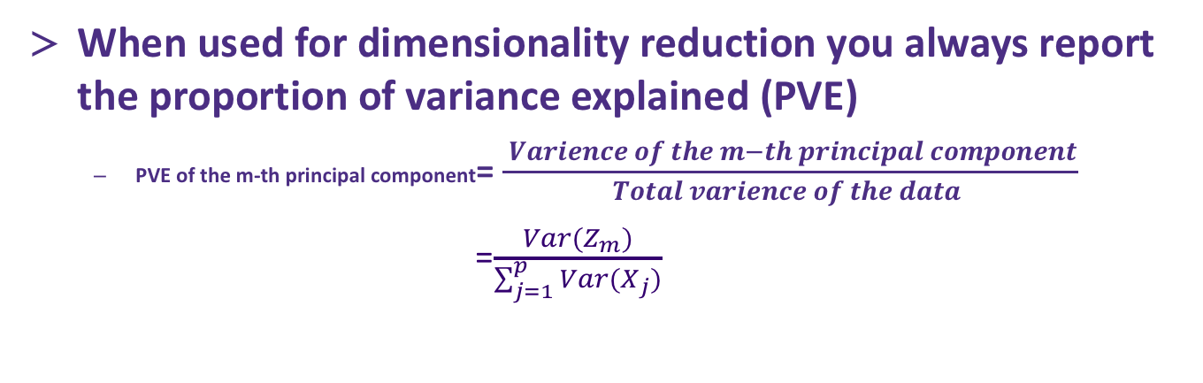
PCA summary
When used for dimensionality reduction you always report the proportion of variance explained (PVE)
PVE of the m-th principal component= $\frac{ Varience of the m−th principal component}{Total varience of the data }$
=$\frac{Var(Z_{m})}{\sum_{j=1}^{p}{Var(X_{j})}}$

Slide 11
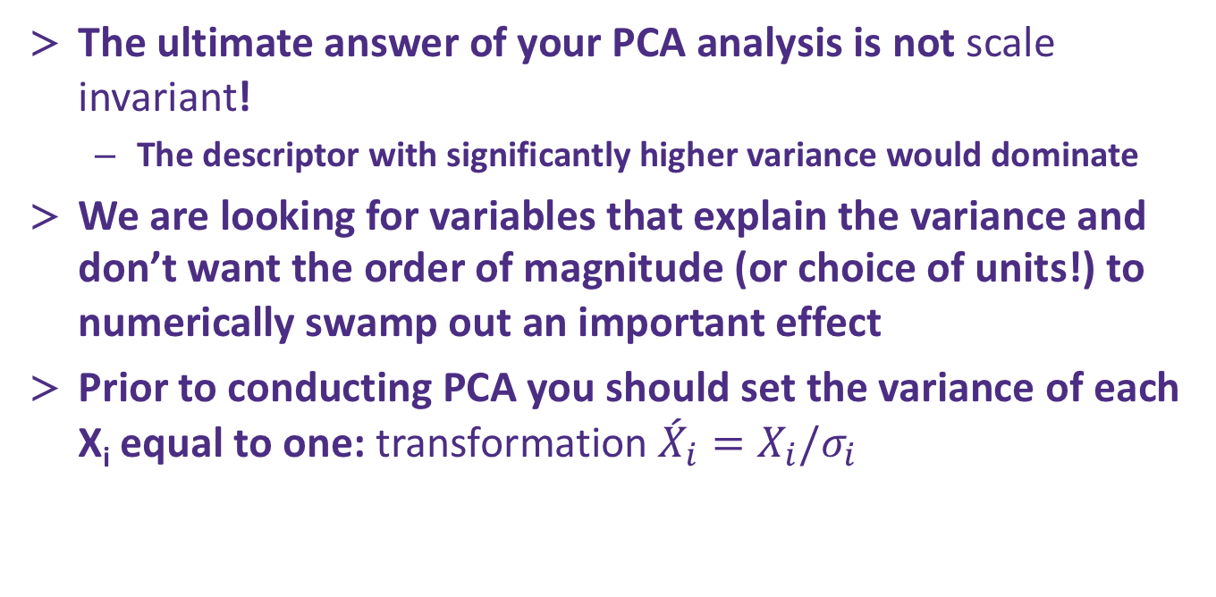
PCA analysis results may depend on the scale of X_{i}!
The ultimate answer of your PCA analysis is not scale invariant!
The descriptor with significantly higher variance would dominate
We are looking for variables that explain the variance and don’t want the order of magnitude (or choice of units!) to numerically swamp out an important effect
Prior to conducting PCA you should set the variance of each X_{i} equal to one: transformation ${{\acute{X}}_{i}=X}_{i}/σ_{i}$

Slide 12
How to use principal components
PCA is usually an “exploratory” method
Sometimes you may do PCA to reduce the dimensionality of your data then apply another clustering or regression method

Slide 13
Python implementation and tips
PCA can become expensive to calculate, especially as the data set size grows
As a result there are often many methods to pick from
Implementation is easy and many tutorials online, sklearn PCA is well supported
Advice
Go slow and use a subset of your data (if you have many points)
Use PCA as a guide and as an exploratory tool
Constantly interrogate the results and ask if they make sense! You don’t have “test set error” to fall back on, so you need to use your brain!

Slide 14
PCA questions?

Slide 15
Clustering
Our other main tool in unsupervised learning is clustering
Clustering seeks to partition the data into distinct groups so that the data points within the same group are similar to each other
K means clustering
A commonly used and simple clustering method

Slide 16
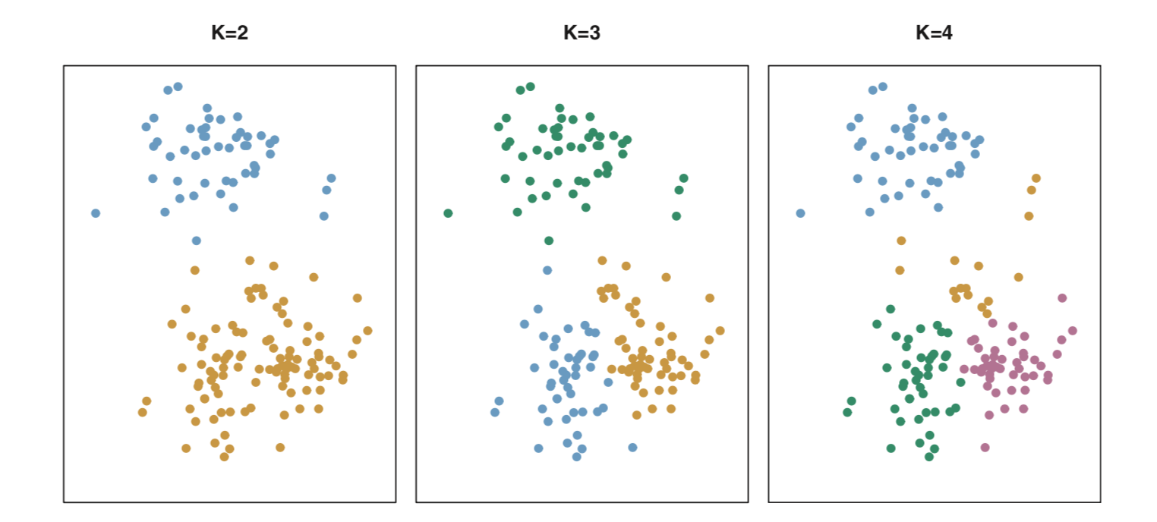
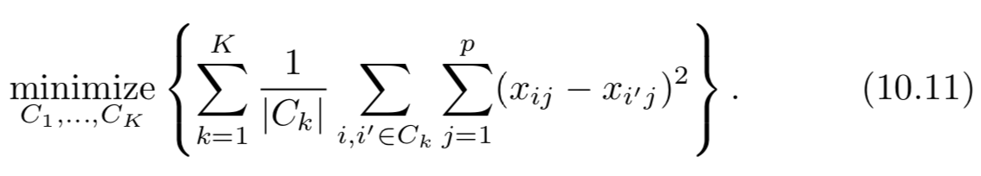
K-means clustering, a simple algorithm
Requires, as an input, specification of the final number of clusters you want (K)
Rules:
Each observation must be placed in at least one of the clusters
No clusters may overlap, each observation can only be placed in a single cluster
The goal is to minimize the variance of observations within each of the clusters (usually defined by squared Euclidean distance)

Slide 17
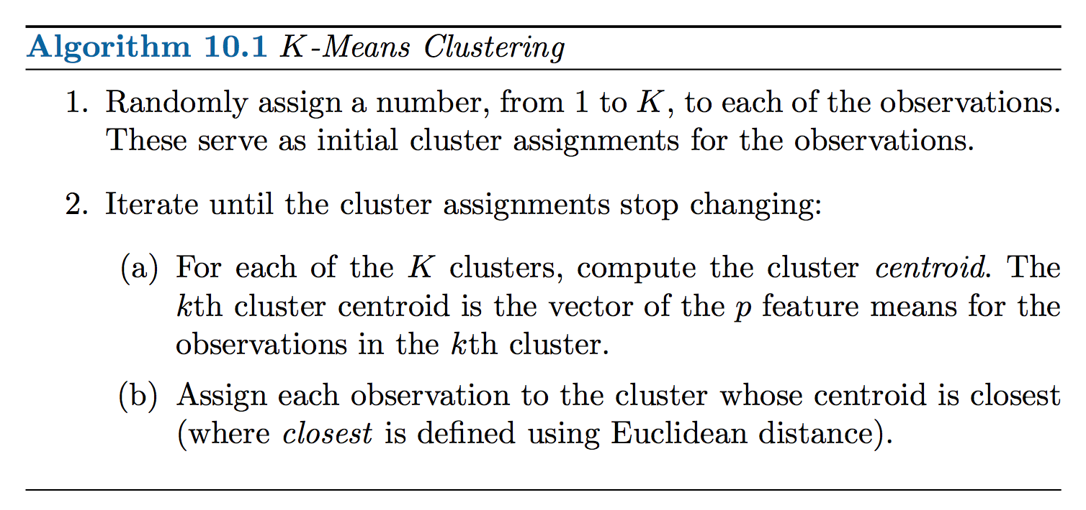
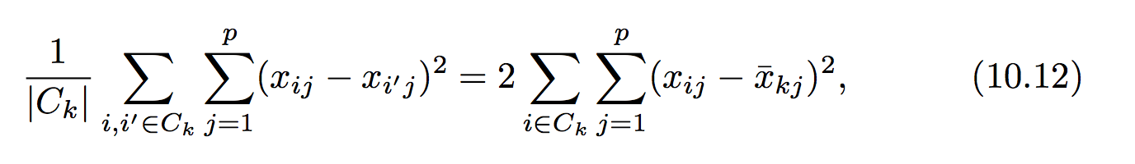
Algorithm for K-means
Goal:

Slide 18
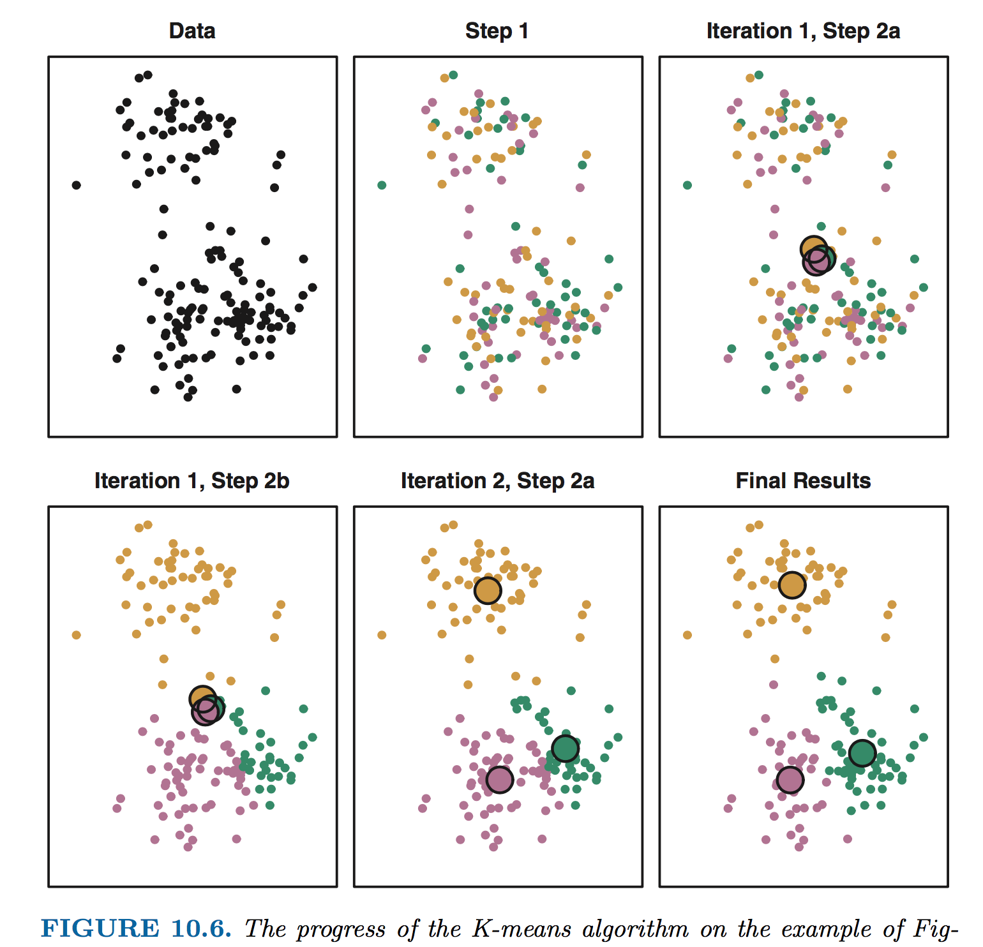
Algorithm for K-means (e.g., K=3)

Slide 19
Importance of sampling
K-means clustering is a stochastic process
Initial random assignment of data to classes
The optimization scheme leads to a local optimization , it is not guaranteed to find the global minimum
Process
Re-seed different initial clusters and repeat optimization of cluster centers / assignments
Monitor the sum of distances (each point’s distance from each cluster center) as your error metric
Choose clustering arrangement with lowest error

Slide 20
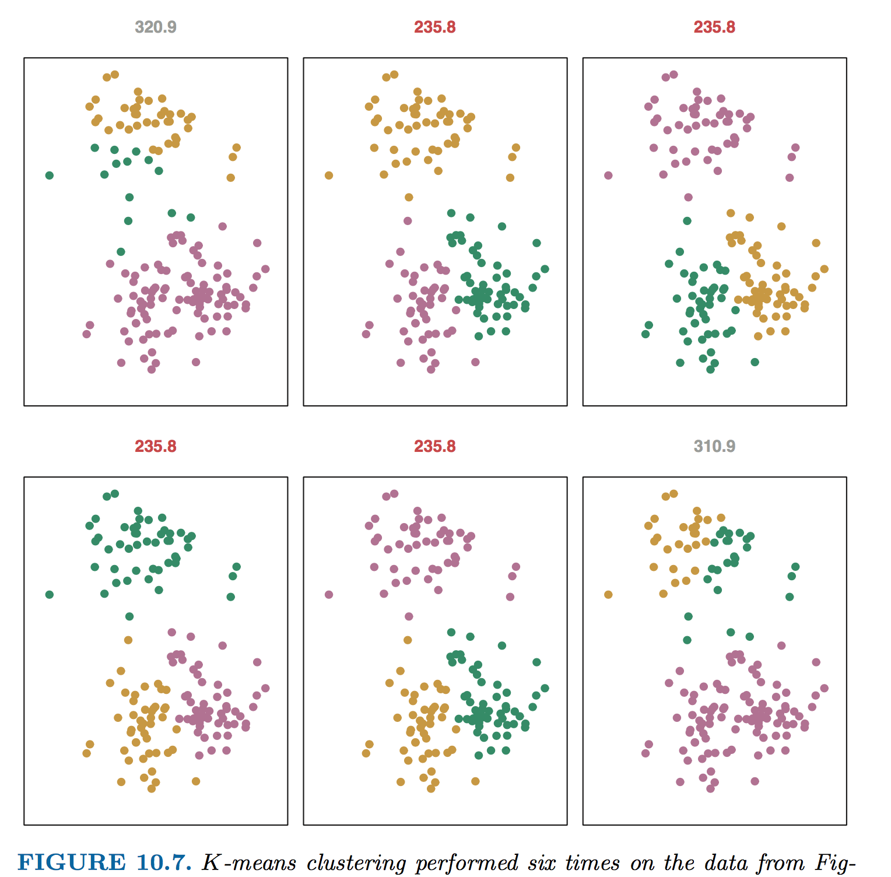
Importance of sampling

Slide 21
What to do with your clusters
As in PCA, clustering is an exploratory analysis tool
If you have clustered your observations (most common): you can interrogate the different clusters to see if they have common features
For observations with many features, you can also cluster the features and look @ common observations … (transpose your X)
In K-means, you have to choose the number of clusters: you must assess the degree to which this choice makes an impact on your scientific conclusions!

Slide 22
Performing K-means clustering
The module sklearn.clustering can perform K-means and has many variants
Take care as with PCA if the size of your data set grows, the computational cost to complete the clustering can become prohibitive…

Slide 23
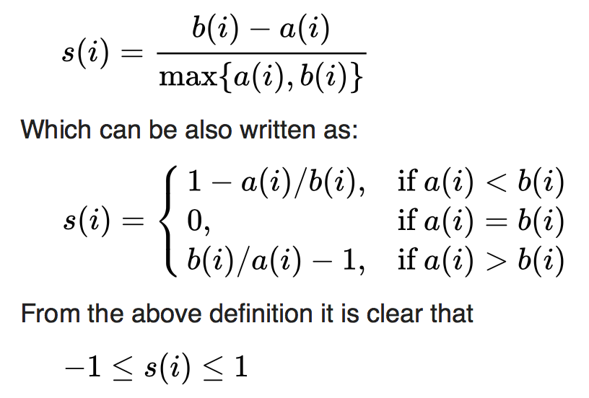
Evaluating K-means clustering
Silhouette analysis
For point i in a cluster
Compute the average distance to other points within the same cluster a(i)
Compute the average distance to the points in the next closest neighboring cluster b(i)
The silhouette for a given point is s(i)
From wikipedia

Slide 24
Evaluating K-means clustering
Silhouette analysis
From sklearn website

Slide 25
Clustering vs PCA
Simple definition in ISL (p385):
“PCA looks to find a low-dimensional representation of the observations that explain a good fraction of the variance”
“Clustering looks to find homogeneous subgroups among the observations”
Unsupervised learning, especially use of results, can be a bit of an art…
In some cases, it might be appropriate to look at both approaches

Slide 26
Clustering questions?

Slide 27
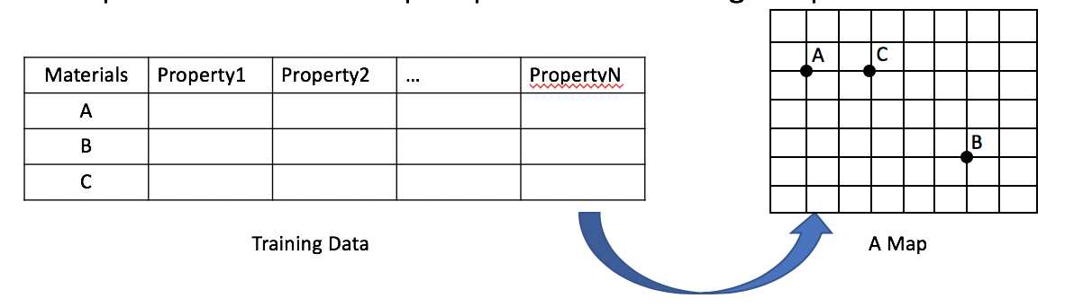
Self-organizing map (SOM)
An unsupervised learning method: Interpret and visualize the data, not predict
Produce a low-dimensional (typically two-dimensional), discretized representation of the input space of the training samples

Slide 28
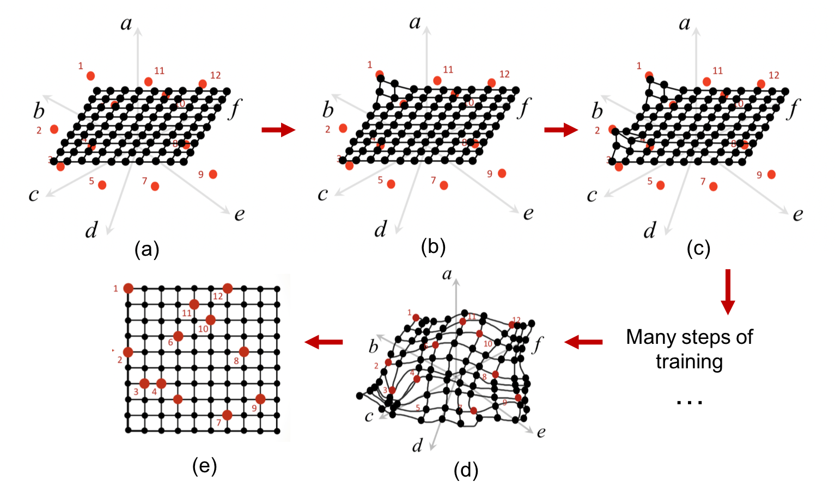
How it works: the training process
Define mesh: a set of nodes (black dots) with initial coordinates in N-dimensional space spanned by training data points(red dots)
(b)(c) Drag each nodes to approach the points in training dataset
(e) Flatten it
(d). Each nodes get close enough to the training data points.
J. Qian et al. (2019). Introducing Self-Organized Maps (SOM) as a Visualization Tool for Materials Research and Education, Results in Materials. 4(October), 100020.

Slide 29
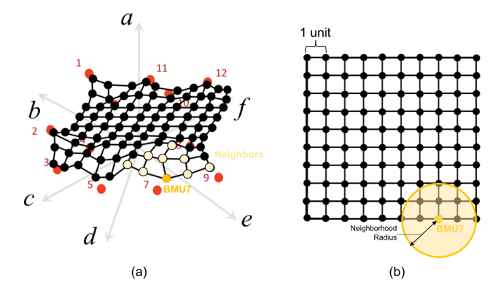
Algorithm: how the nodes are updated in each iteration of training process
A data point is chosen. Point 7 is chosen as shown below
Find the closest node to the chosen point in terms of the Euclidean distance in the multi-dimensional space. The node is called ‘Best matching unit’ (BMU) to the chosen training data point.
Find the neighbors of the BMU within a given neignborhood radius. Note that the radius refers to the distance on the 2D topology of the mesh.
Repeat 2)-4) to identify all the BMU and neighbors of the BMU
Update the coordinates the BMU and its neighbors in a way that makes them closer to their matching training data point.
J. Qian et al. (2019). Introducing Self-Organized Maps (SOM) as a Visualization Tool for Materials Research and Education, Results in Materials. 4(October), 100020.

Slide 30
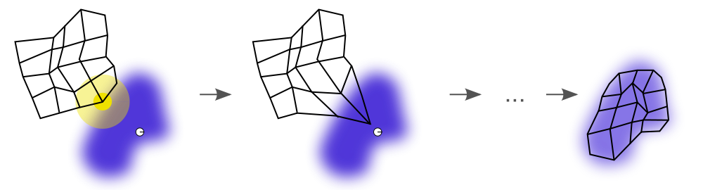
Evaluate the result
Quantifying the error of the approximation:
The quantization error: average distance between each training data vector and its BMU.
The topographic error: the proportion of all training data vectors for which first and second BMUs are not adjacent nodes.
(https://github.com/sevamoo/SOMPY/blob/master/sompy/examples/california_housing_rectangular_grid.ipynb)
(from wikipedia)

Slide 31
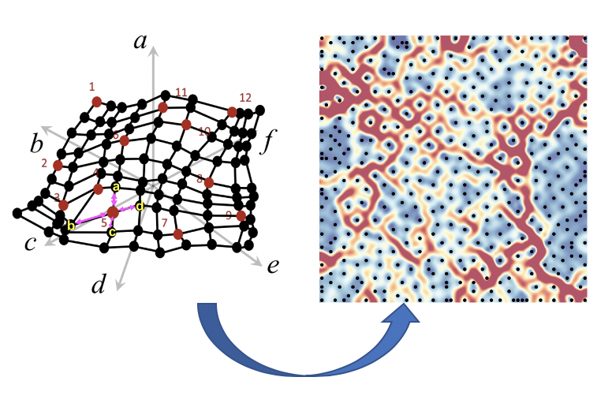
Visualize the self-organizing map(SOM)
U-matrix map:
J. Qian et al. (2019). Introducing Self-Organized Maps (SOM) as a Visualization Tool for Materials Research and Education, Results in Materials. 4(October), 100020.

Slide 32
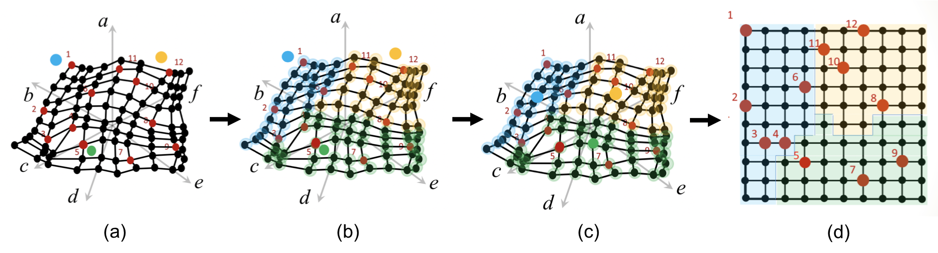
Visualize the self-organizing map(SOM)
Perform K-clustering on the map:
Training K-clustering based on the coordinates of the nodes
J. Qian et al. (2019). Introducing Self-Organized Maps (SOM) as a Visualization Tool for Materials Research and Education, Results in Materials. 4(October), 100020.

Slide 33
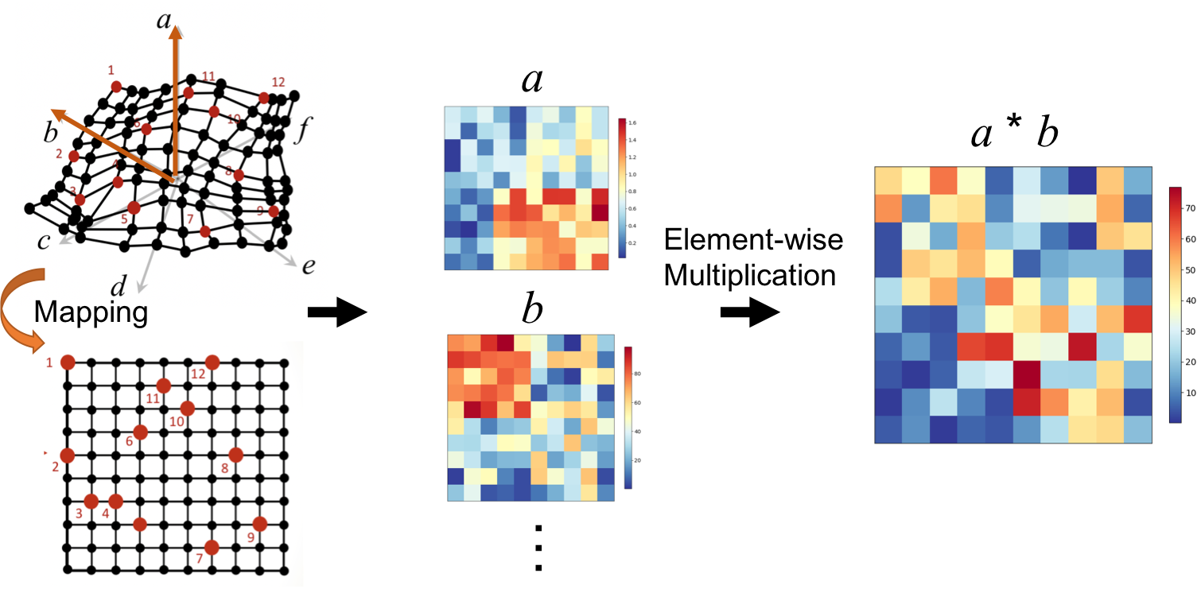
Visualize the self-organizing map(SOM)
Heatmaps
J. Qian et al. (2019). Introducing Self-Organized Maps (SOM) as a Visualization Tool for Materials Research and Education, Results in Materials. 4(October), 100020.

Slide 34
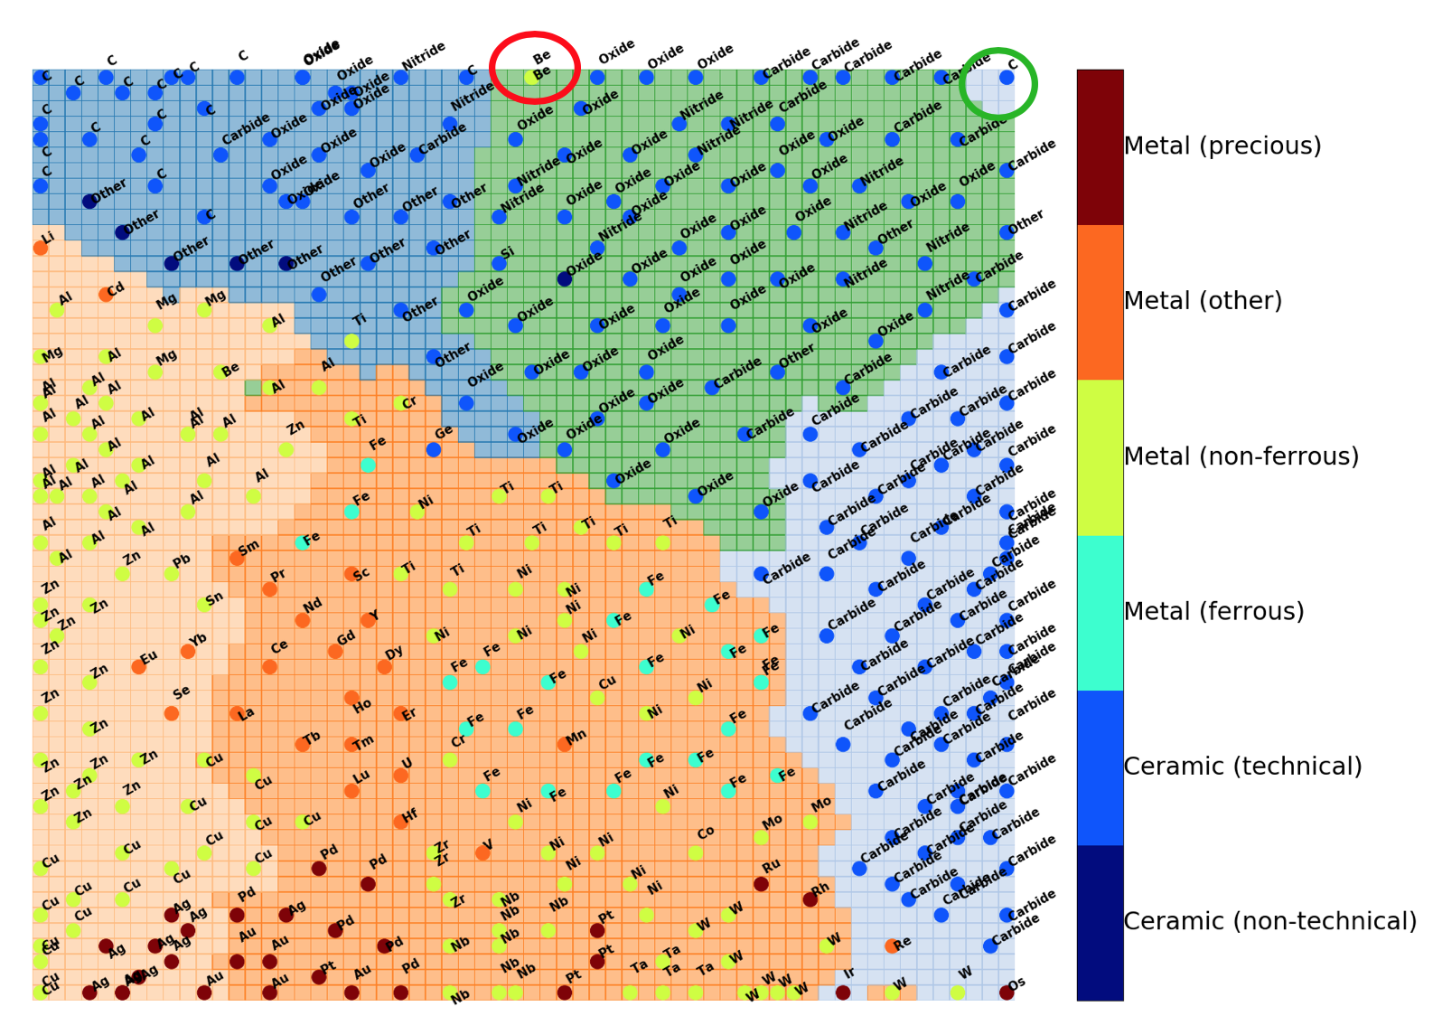
SOM visualization of Materials dataset
Train SOM with a materials dataset containing ~400 materials with their 21 properties.
Colored each point by its category
The label/color of each points can indicate qualitative/categorical property of material
Data is from Granta data base (https://grantadesign.com)
J. Qian et al. (2019). Introducing Self-Organized Maps (SOM) as a Visualization Tool for Materials Research and Education, Results in Materials. 4(October), 100020.

Slide 35
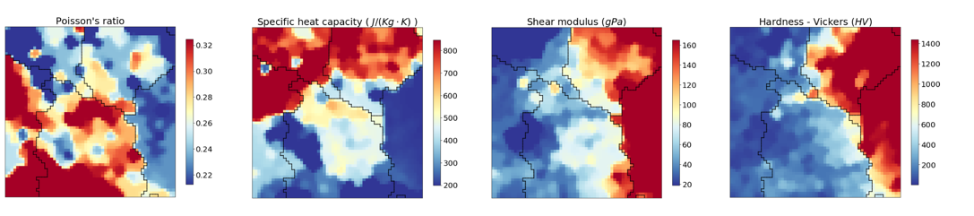
SOM visualization of Materials dataset
Heatmap: mapping the distribution of the materials properties on SOM
Data is from Granta data base (https://grantadesign.com)
J. Qian et al. (2019). Introducing Self-Organized Maps (SOM) as a Visualization Tool for Materials Research and Education, Results in Materials. 4(October), 100020.

Slide 36
SOM question?

Slide 37
Thank you!

